Slide 1

Level: Advanced
Game Development with Unity
Omid Saadat

Slide 2
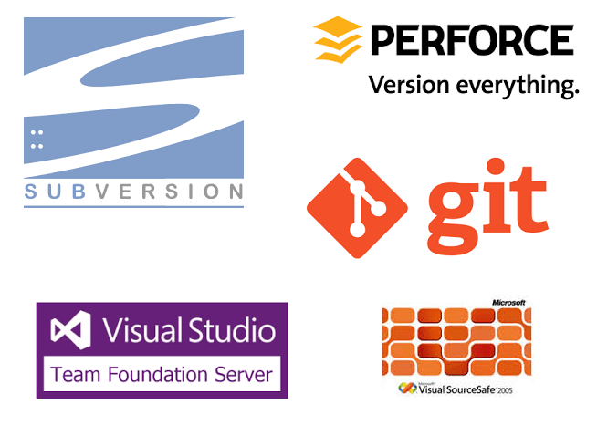
Pick a VCS first
What is a Version Controller?
Which one should I pick? (Hint: Git)

Slide 3

Using Git with Unity
CLI
Unity .gitignore
Git LFS
Want to go Online?
  Public: GitHub
  Private: GitLab

Slide 4
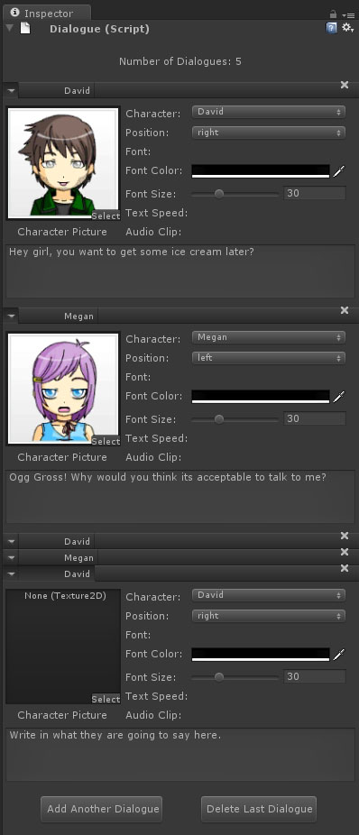
Customizing Unity
Property Drawer
Custom Inspector
Custom Window

Slide 5
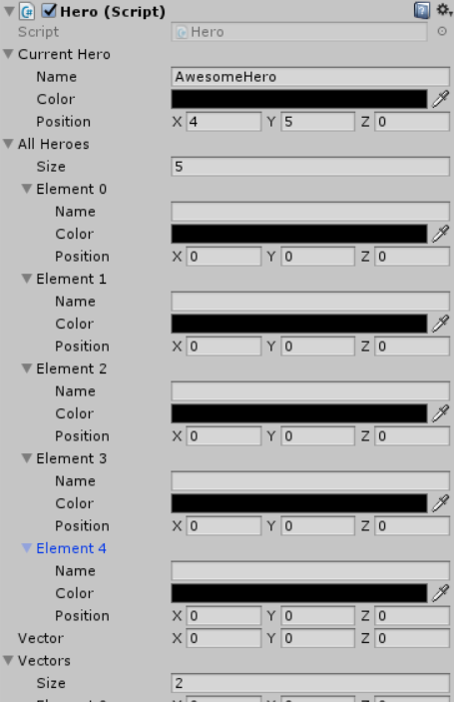
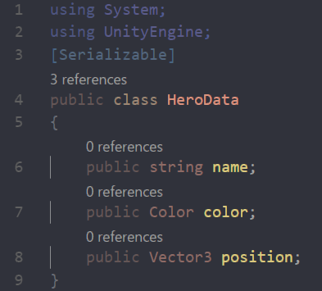
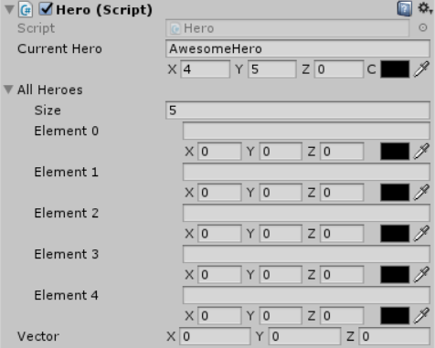
Property Drawer
Customize a drawer for your class
Before:
Serialized Class:
After:

Slide 6
Property Drawer
Your main class must be serialized.
Drawer will be shown every where.
[CustomPropertyDrawer(typeof(HeroData))]
Inspired from Catlikecoding.com example

Slide 7
Hands on the keyboard!
Lest check how this work in action

Slide 8
Practice
Draw a 3 lined PropertyDrawer for your own serialized class.

